Slide 1
Hasan Yasar - Nicolas M. Chaillan
Department of Defense
DevSecOps
Cultural Transformation

Slide 2
Agenda
Why does DevSecOps matter?
Pathway to DevSecOps
The DoD Enterprise DevSecOps Initiative
DevSecOps Architecture

Slide 3

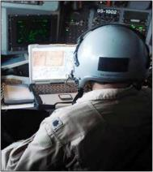

DoD Depends on Software but Does Not Always Control Development
Software and system complexity is increasing software cost and vulnerability and jeopardizing military capability
DoD does not produce most of the software it uses, but it must maintain that software
More and more capability results from software and it will evolve for the lifetime of a system
Latent cyber vulnerabilities, those exposed during operations, and those due to underlying dependencies are putting the DoD at risk
Finding and fixing problems late causes rework and drives up costs
Software cost overruns are overwhelming program delivery and sustainment
Modern software development and automated tools are critical
Notes:
Even the most “mechanical” of DoD weapons and capability is dependent on software… any effect DoD needs to achieve , across any service or platform, the mission is 100% reliant on software. This is promise of software… COMPLEXITY is the grand enabler .,.. But the rapid growth in complexity is driving cost and security to accelerate at a faster rate than military capability…. Leaving gaps and vulnerabilities that will JEOPARDIZE military capability… if not reigned in… Complexity is not the enemy…
DoD is not realizing the full potential of software as the means to maintain competitive advantage (as in its central role in autonomy) because it suffers from capability gaps in tools to predict and control software (thus system) costs and practices to gain and ensure secure operation and resiliency.”
If only the scary stuff about software is the problem, then we are part of it, having been chartered by DoD to focus on software for 30 years.
But if the potential of software is the solution, then we have value as part of finding answers.

Slide 4
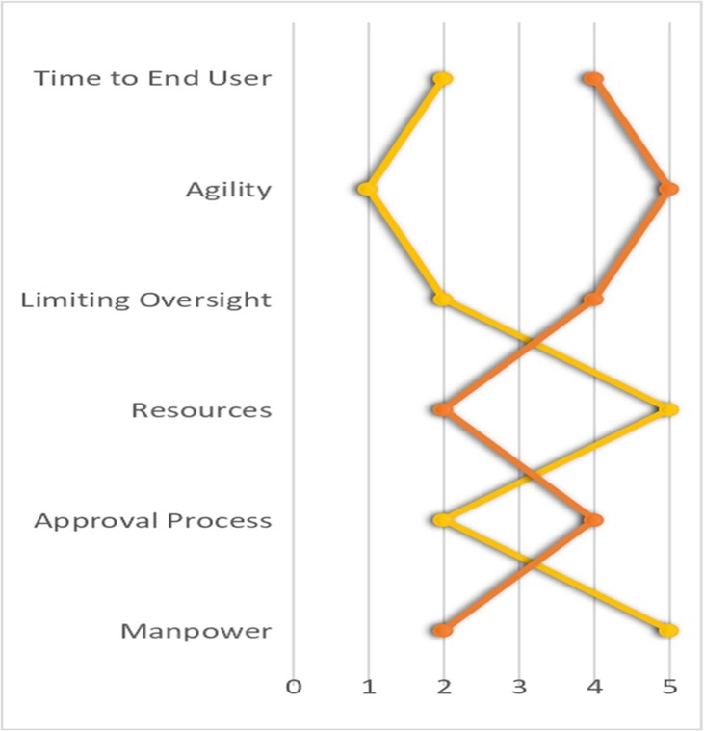
DoD vs Private Sector
Current Acquisition process attribute map
“Simply delivering what was initially required on cost and schedule can lead to failure in achieving our evolving national security mission — the reason defense acquisition exists in the first place.”
Honorable Frank Kendall Under Secretary of Defense (AT&L) 2015 Performance of The Defense Acquisition System
Most important to end user
DOD Private
“As we reorganize the way we do business the thread that runs through all of our programs and all that we do is software and I believe that we need to catch up with the private sector and make sure we are using contemporary software development processes,”
The Honorable Ellen Lord,
Under Secretary of Defense,
Acquisition and Sustainment
Least important to end user
*NAVAL Special Warfare Operator study
DevSecOps Academy | 9 Jul, 2019
4

Slide 5
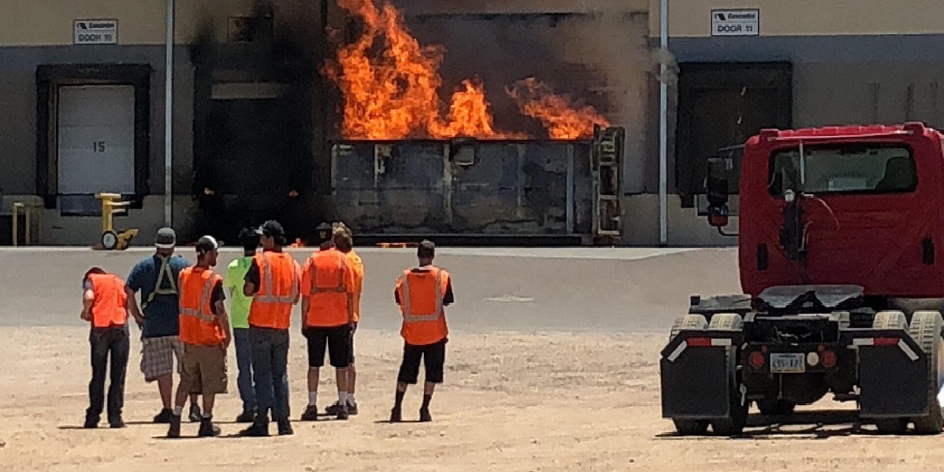
Problems : SW Development/Integration and Delivery
Heavy waterfall process on every phases of software development lifecycle
Long cycle times between each deliveries, 1-2 years
Manual, error‐prone build, integration and deployment times measured in weeks, months, or even years
Integration hell on various levels
Very late stage integration with manual testing for 5 or more years
Anti‐Parity across development, integration and production environments
6‐12 months to manually deploy and test the code in a production environment
Code and unit test cycles occurring in weeks as opposed to hours
End‐to‐end, system integration testing occurring in months vs days or hours
Very long ATO(Authority-to-Operate) process→ 6-18 months

Slide 6



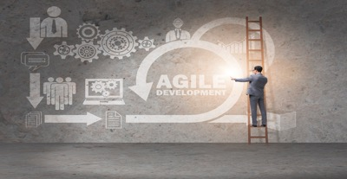
Lots of Barriers…..
Complex systems (Safety critical, Realtime, Embedded Systems..)
Sustainment of DevSecOps pipeline
Tool updates, project configuration, tool license cost,
Effective usage of the platform, combability with the program needs
Lack of iterative and incremental mindset cultural issues
Blame-Free Culture, Cross-Silo Goals, Optimize Ease-of-Use
Organizational Structure
Siloed on Acq, O&M and Security departments, Org structure based on system architecture
Legacy Systems
Lack of modular architecture, old tools/language
Lack of Metrics and Measurements

Slide 7
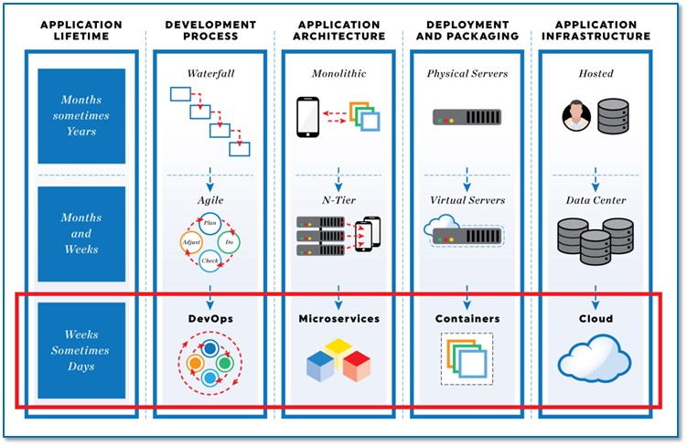
Parallel Efforts to DevSecOps

Slide 8
Problem Statement
The Department of Defense (DoD) is mostly still using Waterfall software methodologies with software delivery every 3 to 10 years, making it impossible to keep up with the pace of technology.
The DoD Authority to Operate (ATO) accreditation process to accredit software takes on average 8 months and is mostly manual with several testing and cybersecurity gates.
Most of the Defense Industrial Base (DIB) (the DoD contractors and developers) has not adopted an Agile and/or DevOps mindset.
Massive organization with large silos and large workforce.
Limited IT enterprise services, Cloud access and high speed connectivity.

Slide 9
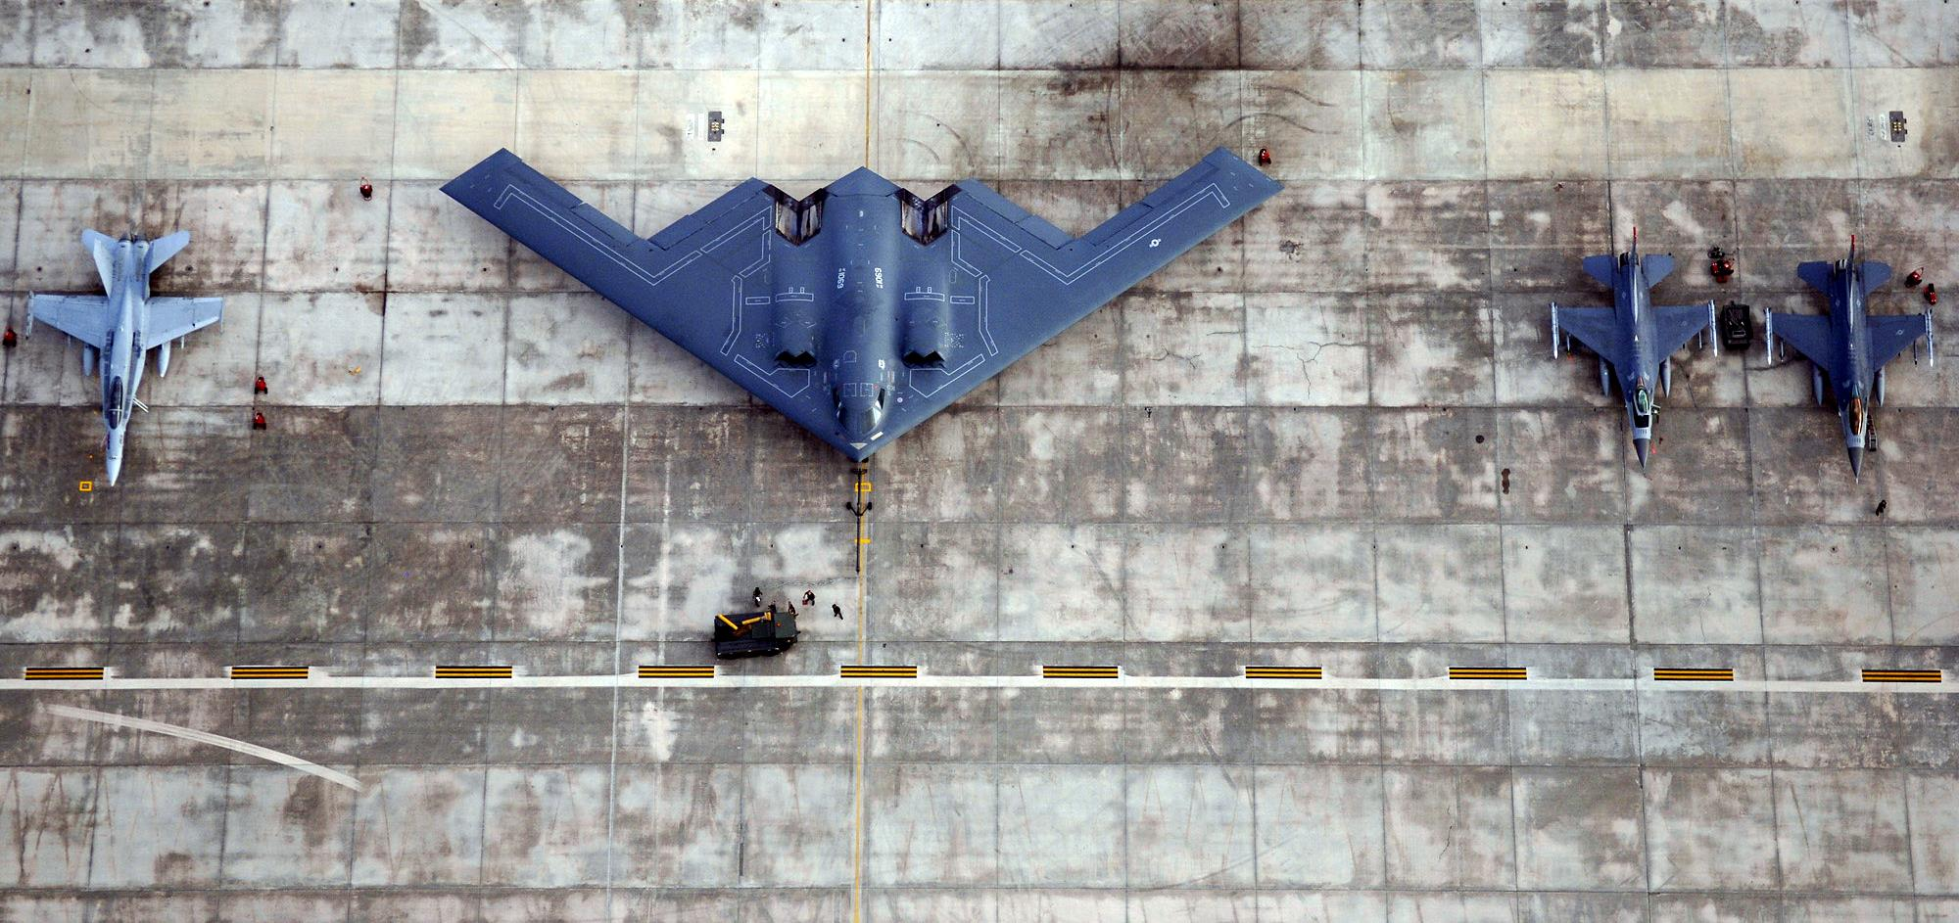

Slide 10


Slide 11


Slide 12
DoD Enterprise DevSecOps Initiative
Tangible Technology – Our entire DevSecOps stack is open source and public, please contribute!
Avoid vendor lock-in at the Infrastructure and Platform Layer by leveraging FOSS with Kubernetes and OCI containers,
Creating the DoD Centralized Artifacts Repository (DCAR) of hardened and centrally accredited containers: selecting, certifying, and securing best of breed development tools and software capabilities (over 170+ containers) - https://dccscr.dsop.io/dsop/ and https://dcar.dsop.io
Baked-in Zero Trust Security with our Sidecar Container Security Stack (SCSS) leveraging behavior detection, zero trust down to the container/function level.
Leveraging a Scalable Microservices Architecture with Service Mesh/API Gateway and baked-in security (Istio)
Leveraging KNative to avoid lock-in to Cloud provider Serverless stacks
Customized Open Policy Agent (OPA) Policies!
Bringing Enterprise IT Capabilities with Cloud One and Platform One – Cloud and DevSecOps as Managed Services capabilities, on-boarding and support!
Standardizing metrics and define acceptable thresholds for DoD-wide continuous Authority to Operate
Massive Scale Training with Self Learning Capabilities (train over 100K people within a year) and bring state of the art DevSecOps curriculum
Creating new Agile contracting language to enable and incentivize the use of DevSecOps

Slide 13


Understanding the DevSecOps Layers
Continuous Monitoring
Leverages the Sidecar Container Security Stack
Development Teams can build software/microservices leveraging hardened containers
Application
Layer
Brings baked-in security and
Microservices architecture enablement
Platform
One
Service Mesh
Layer
Fully containerized, leverages DoD approved containers from DCAR
Development Team selects tools from 172 approved containers or custom containers
Continuous Integration / Continuous Delivery
(CI/CD) Layer
CNCF compliant Kubernetes (K8S)
Includes Site Reliability Engineers (SREs) etc.
Development Team selects between approved K8S stacks
Platform
Layer
Environment Agnostic
Cloud One Preferred for unclassified (IL2, IL4, IL5)
Or SC2S/C2S/FENCES
Or on-premise/classified environments
Cloud One
Infrastructure
Layer

Slide 14



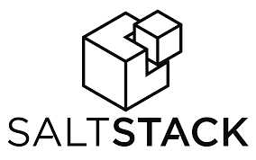
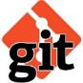





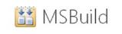






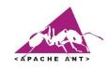







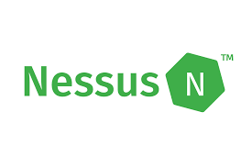

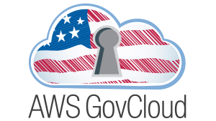








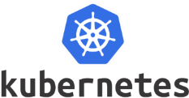


DoD Enterprise DevSecOps
Technology Stack
ENTIRELY CONTAINERIZED
(Exemplar)
PLAN
&
DEVELOP
DEPLOY
&
OPERATE
BUILD
“Continuous Integration &
Continuous Delivery”
Orchestration
MONITOR
TEST
SECURE
SCALE
STORE ARTIFACTS
Container and Container Management

Slide 15
Sidecar Container Security Stack
Baked-in Zero Trust security down to the Container/Function level with Istio (Envoy) and Knative.
Centralized logging and telemetry with Elasticsearch, Fluentd, Kibana (EFK).
Container security: Continuous Scanning, Alerting, CVE scanning, Behavior detection both in development and production (Build, Registry, Runtime) with Twistlock
Container security and insider threat (custom policies detecting unapproved changes to Dockerfiles) with Anchore
Automated STIG compliance with OpenSCAP

Slide 16
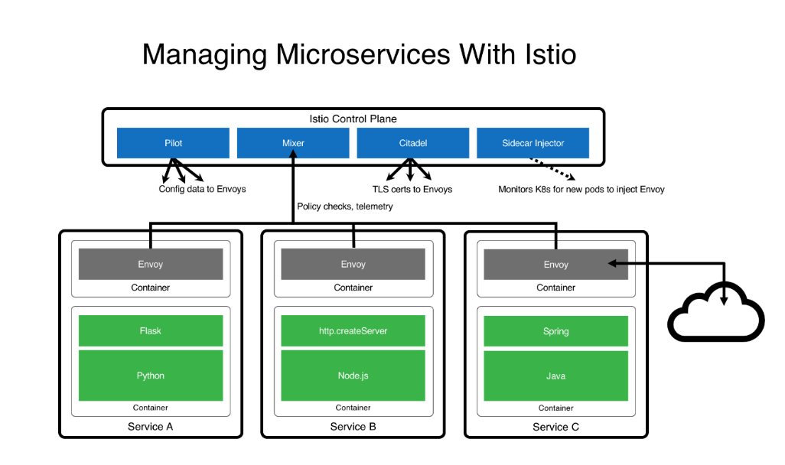
Microservices Architecture (ISTIO)
Turnkey Service Mesh (ISTIO) architecture
ISTIO side car proxy, baked-in security, with visibility across containers, by default, without any developer interaction or code change
Benefits:
API Management, service discovery, authentication…
Dynamic request routing for A/B testing, gradual rollouts, canary releases, resilience, observability, retries, circuit breakers and fault injection
Layer 7 Load balancing
Zero Trust model: East/West Traffic Whitelisting, ACL, RBAC…
TLS encryption by default, Key management, signing…

Slide 17
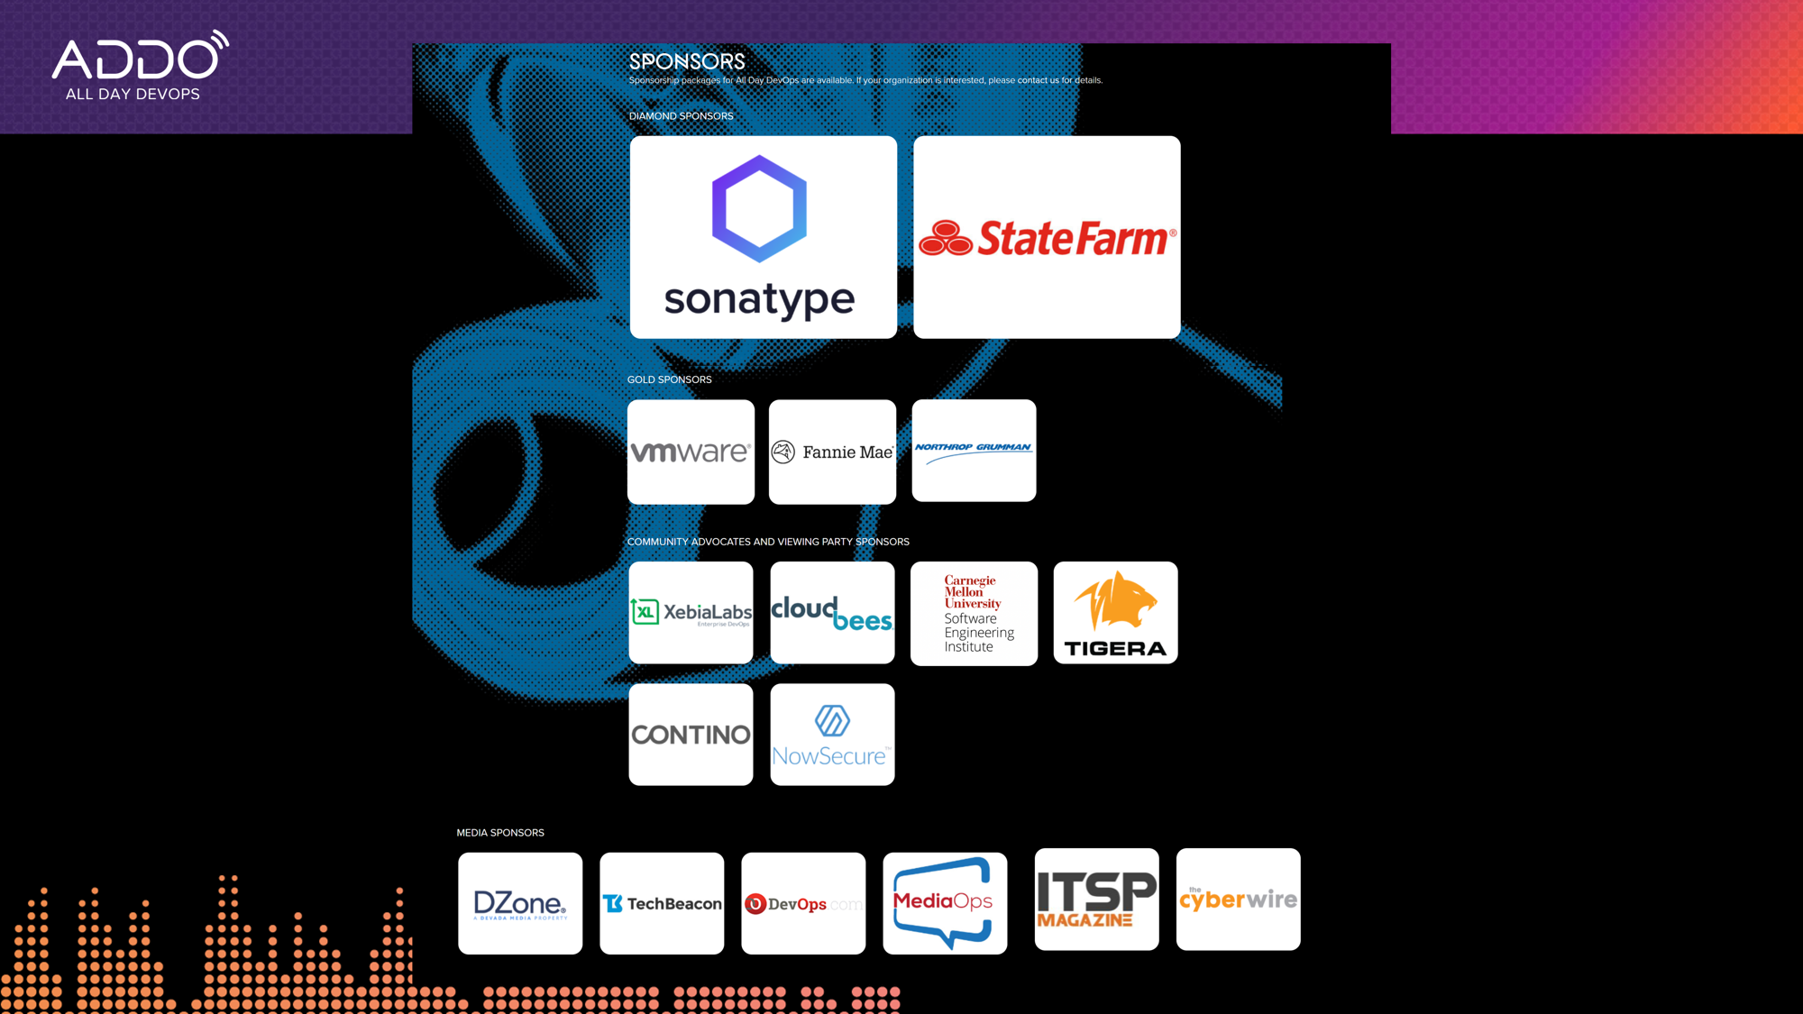

Slide 18
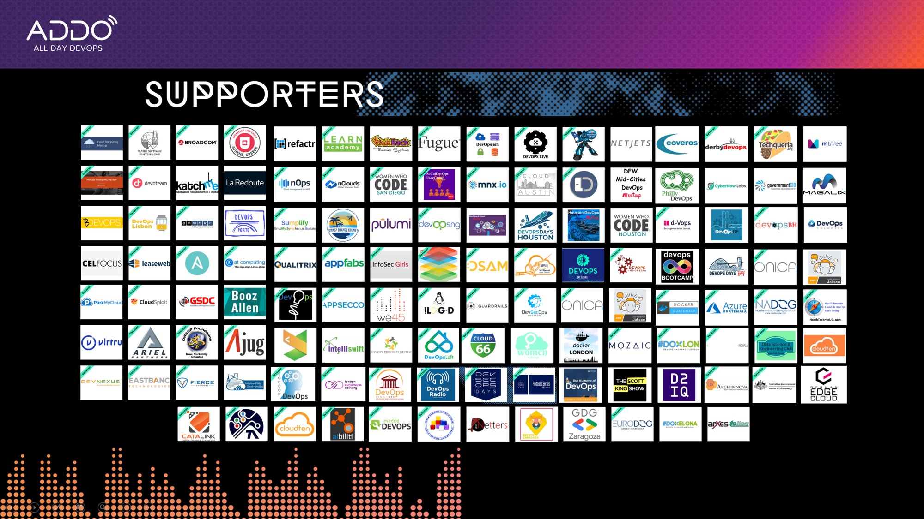

Slide 19

Join/Contact Us!
“If Kubernetes is good enough for DoD weapon systems, it is definitely good enough for your business!”
Thank You!
Nicolas M. Chaillan
Chief Software Officer, U.S. Air Force
https://www.linkedin.com/in/nicolaschaillan/
usaf.cso@mail.mil
Hasan Yasar
Technical Director, Software Engineering Institute CMU
https://www.linkedin.com/in/hasanyasar
hyasar@sei.cmu.edu

